Slide 1

The Importance of Website Optimisation
THANOS PANOGIOTIDIS

Slide 2
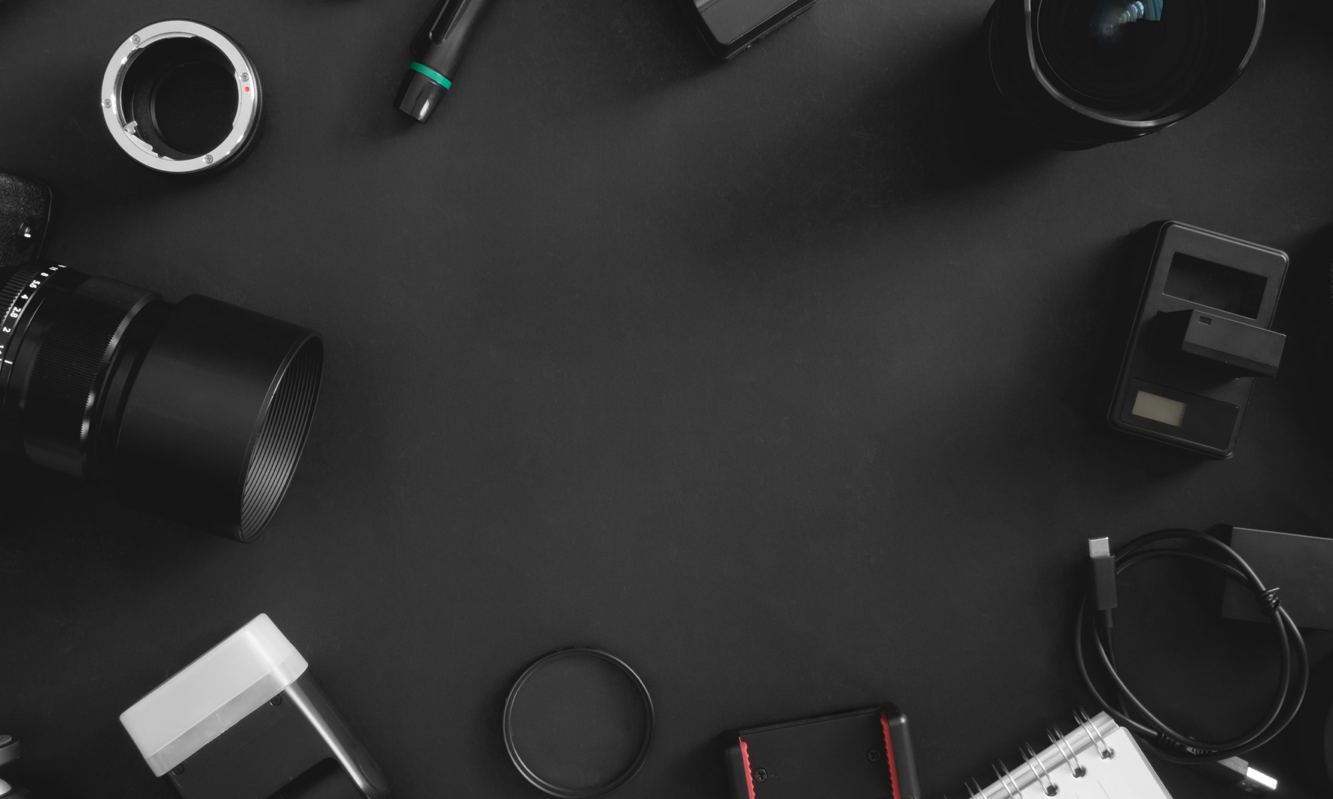

About Identity Creative
Identity Creative is a successful design agency working with a wide range of national and regional clients on a variety of projects across many sectors for over ten years.
We have vast experience in producing the highest quality printed and digital marketing collateral and websites.

Slide 3


Things to discuss today
Comparing 2 sample websites
How important is website optimisation?
Why optimise? Will visitors notice the difference?
What to optimise and how?
Design vs page speed
What is SEO and how the website optimisation will benefit your SEO

Slide 4

70% of Website User are on Mobile Devices
DID YOU KNOW?

Slide 5
Things to ask yourself
LET’S LOOK AT SOME EXAMPLES & COMPARE
Have you got a website?
Is your website mobile friendly?
Is this important to your and your business?
When you Google your business do you come up?

Slide 6


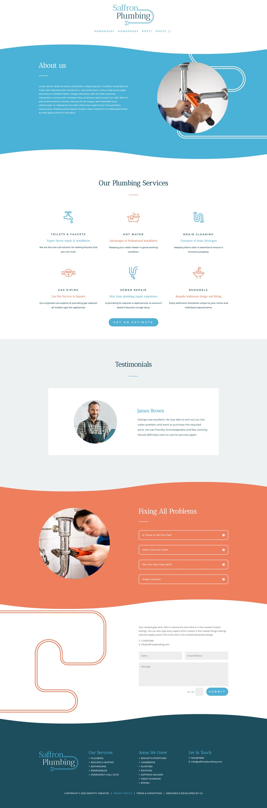
Comparing 2 sample websites
HERE IS ONE WE MADE EARLIER
OPTIMISED VERSION
NON OPTIMISED VERSION

Slide 7
Let’s look at these on phone
PLEASE PULL OUT YOUR PHONES AND SCAN THE QR CODES IN FRONT OF YOU
OPTIMISED VERSION
NON OPTIMISED VERSION

Slide 8
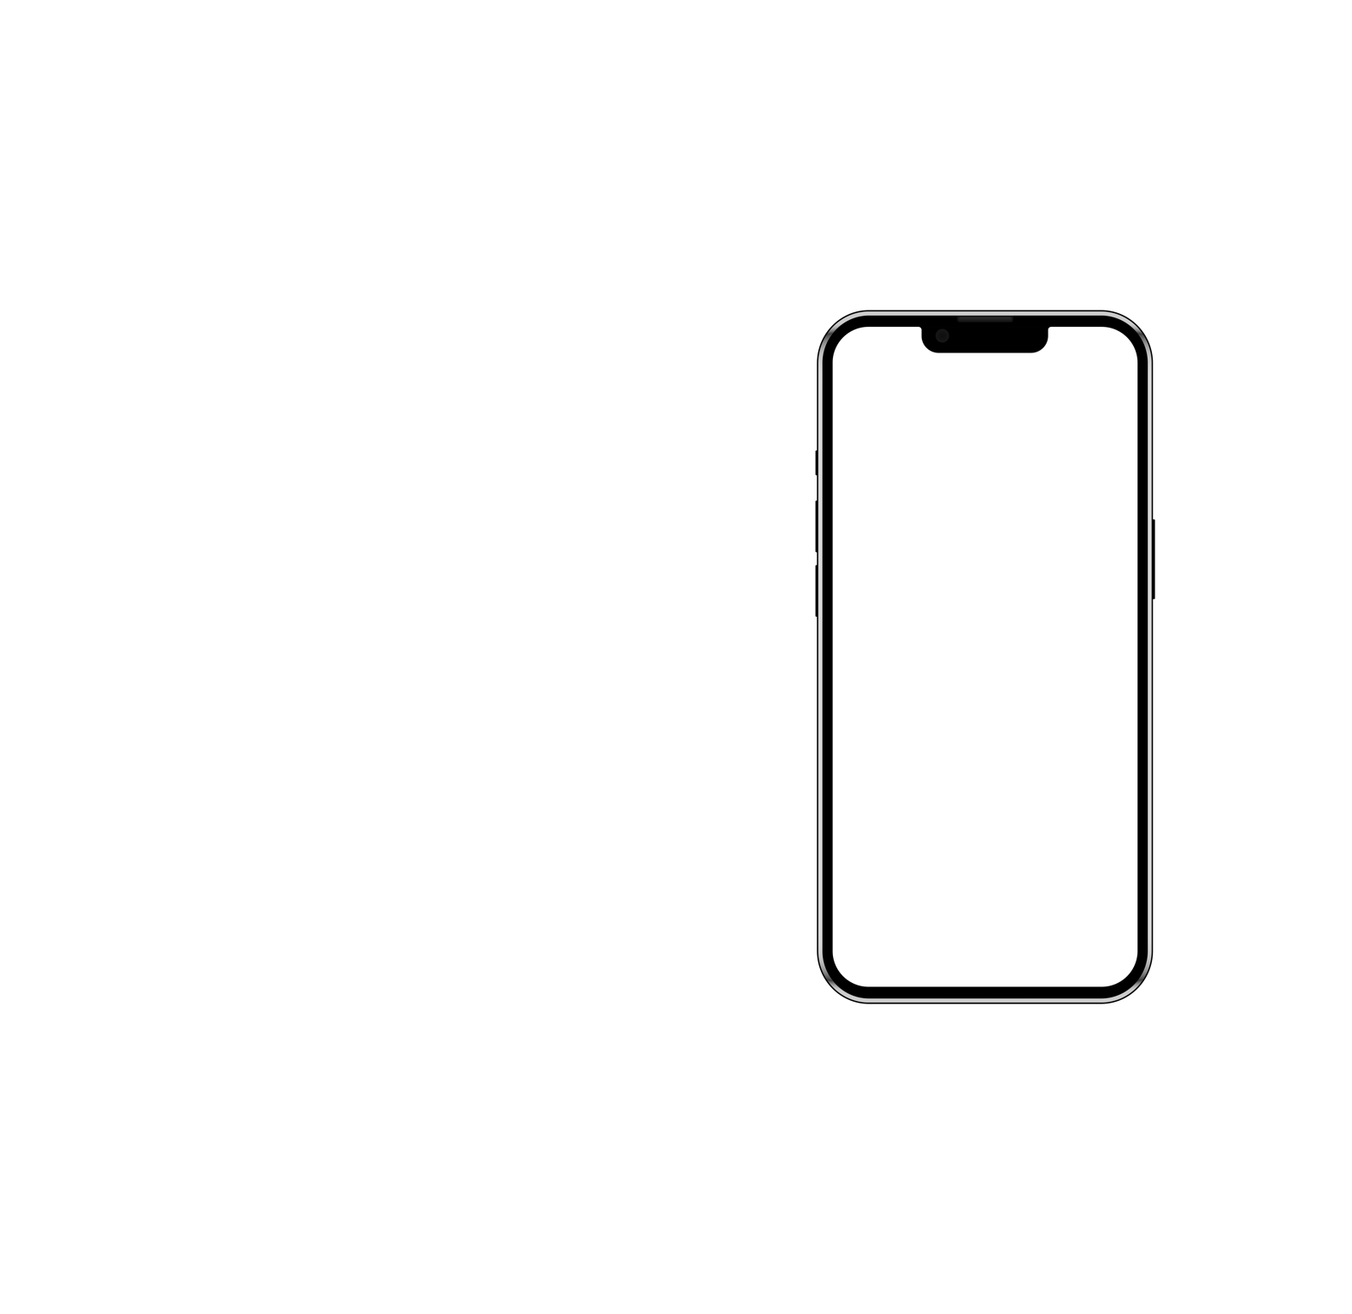

Comparing 2 sample websites
HERE IS ONE WE MADE EARLIER
OPTIMISED VERSION
NON OPTIMISED VERSION

Slide 9


How important is website optimisation?
How does an optimized website help you get more traffic/sales?
Why invest money on a good server?
Website theme and elements, do they affect my website?
I don’t like using my phone to browse on the website, do I still need to optimize it?
It looks great on my phone, that means I don’t need mobile optimization, right?

Slide 10
Why optimise?
WILL VISITORS KNOW THE DIFFERENCE?
Speed
User Experience
Response Time
Readability
Accessibility

Slide 11

What to optimise and how?
WHAT YOU CAN OPTIMISE
YOURSELF
WHAT YOUR WEBSITE PROFESSIONAL CAN OPTIMISE FOR YOU
Images
Videos
Content
Theme Files
PHP & CSS Files
Server

Slide 12
What to optimise and how?
WHAT YOU CAN OPTIMISE
YOURSELF
WHAT YOUR WEBSITE PROFESSIONAL CAN OPTIMISE FOR YOU
Images
Videos
Content
Theme Files
PHP & CSS Files
Server

Slide 13
Design vs Page Speed
IT’S ALL ABOUT BALANCE
Heavy Stylised Plugins
Limited Plugin Use
Long Pages
Multiple Pages
Videos
Compressed Videos
High Quality Images
Optimised Images

Slide 14
What is SEO?
HOW THE WEBSITE OPTIMISATION WILL BENEFIT YOUR SEO?
What SEO stands for?
Is it expensive?
How does it work?
Do I need it?
What happens if my website is not SEO ready? Can I do this later?

Slide 15
Any Questions?
THANK YOU FOR LISTENING

Slide 16
Need Advice?
I’M STICKING AROUND FOR A WHILE, IF YOU WOULD LIKE TO DISCUSS YOUR WEBSITE OR SEEK ADVICE.
OR FEEL FREE TO GRAB A BUSINESS CARD FROM ME AND I HOPE TO HEAR FROM YOU IN THE FUTURE.

